Slide 1
More CSS
XBI 2023 @eamv

Slide 2

CSS Image

Slide 3
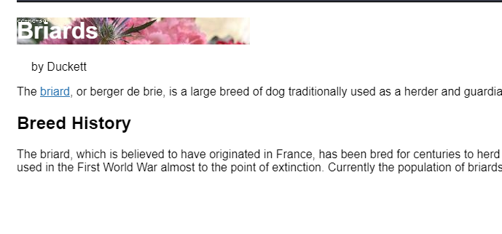
Background image demo
https://codepen.io/tengmushitou/pen/RwpQKZG
Notes:
Can set to any block element

Slide 4
Question
Why use CSS image instead of HTML <img> ?

Slide 5
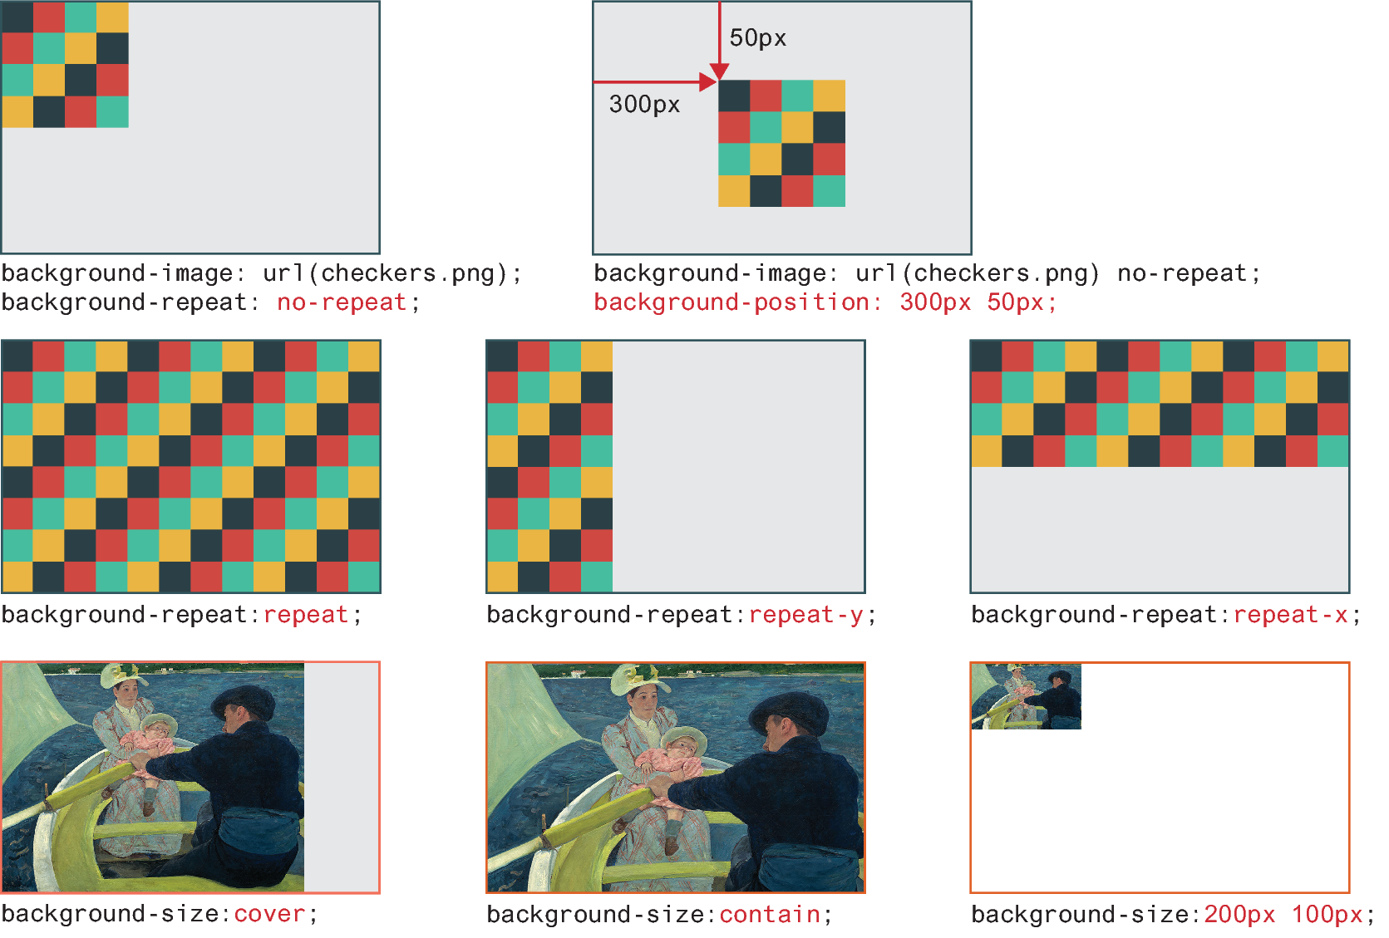
Background image examples
https://developer.mozilla.org/en-US/docs/Web/CSS/background-size

Slide 6
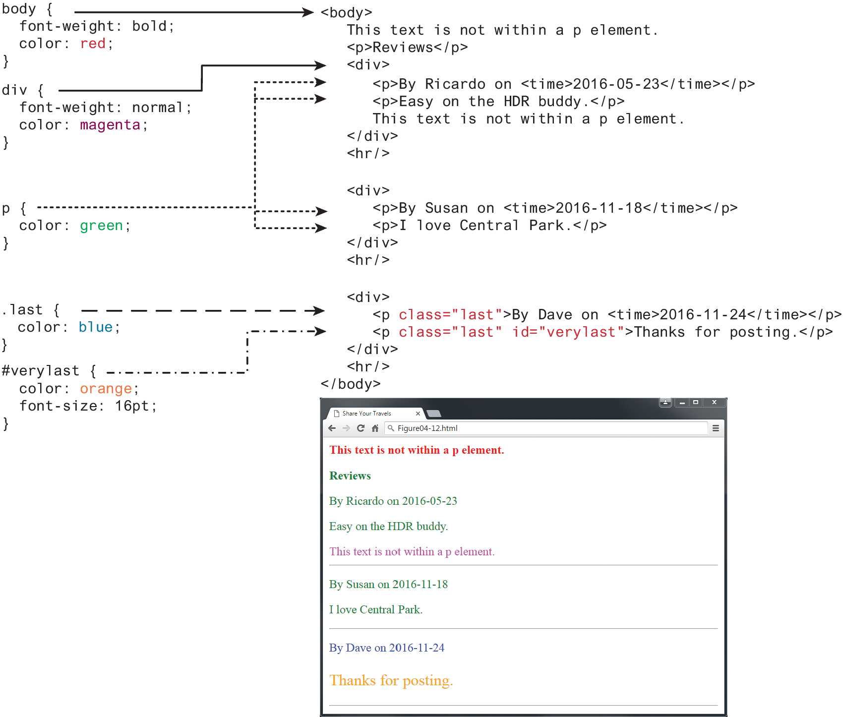
The Cascade: Specificity
Specificity:
The more specific selector takes precedence
Class selectors take precedence over element selectors, and id selectors take precedence over class selectors

Slide 7
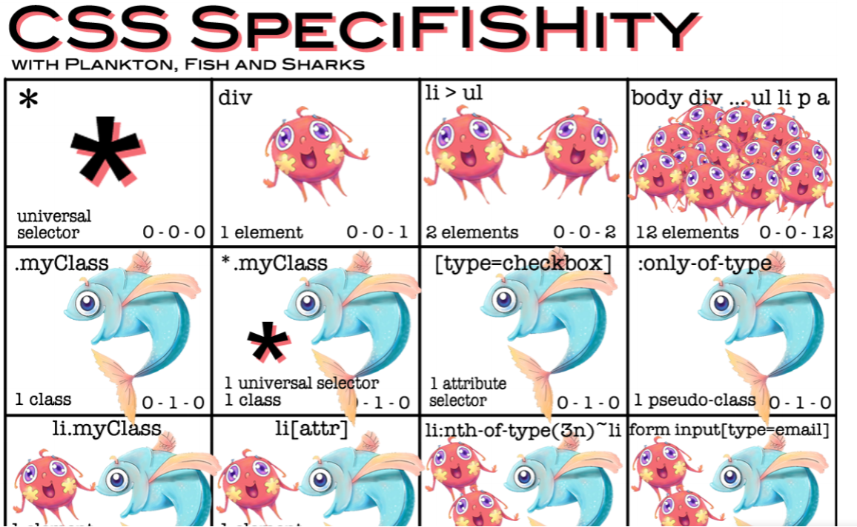


Slide 8
Import styles- font

Slide 9
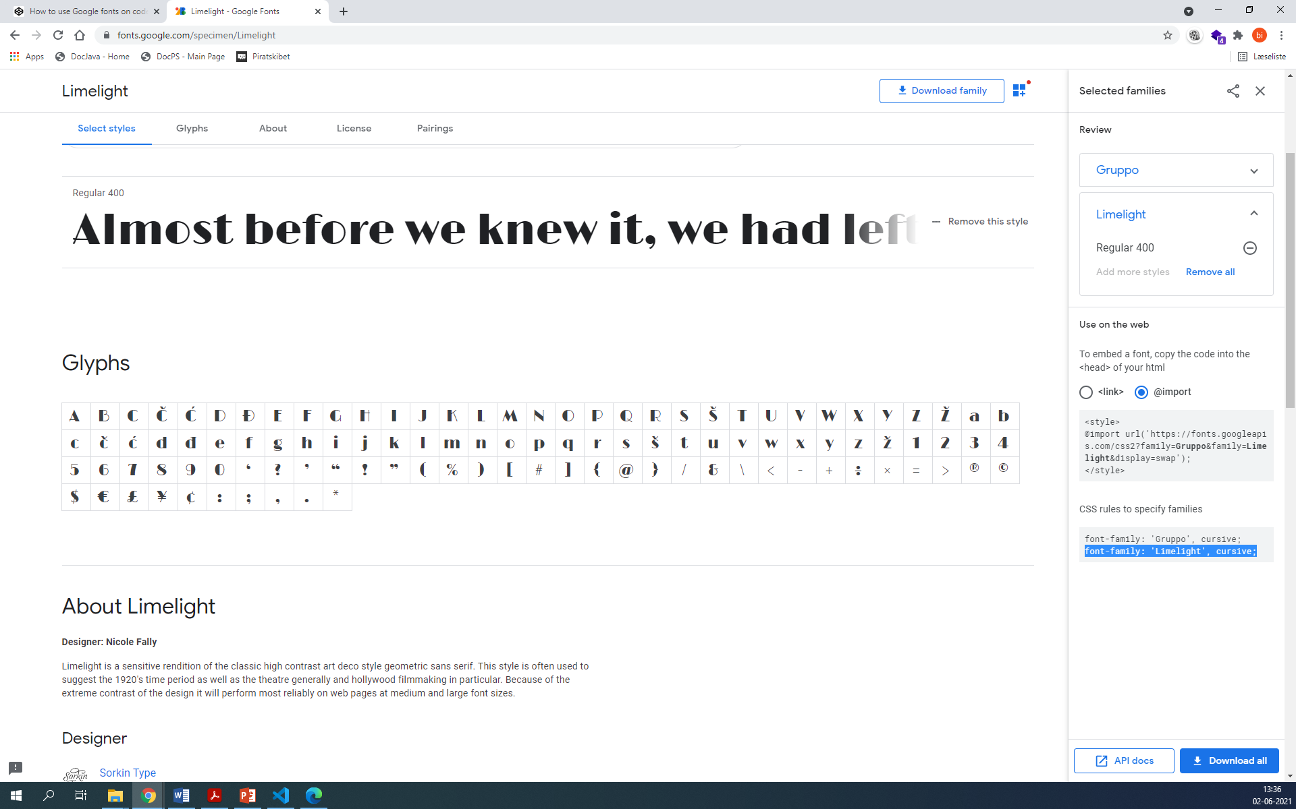
google font
Notes:
https://developers.google.com/fonts/docs/getting_started
Google fonts
https://fonts.google.com/
Andre:
Fonts.com (fonts.com)

Slide 10
Font weight Weight name
100 Thin (Hairline)
200 Extra light (Ultra light)
300 Light
400 Normal
500 Medium
600 Semi bold (Demi bold)
700 Bold
800 Extra bold (Ultra bold)
900 Black (Heavy)

Slide 11
Font Weight
Google Fonts made web fonts available to the masses, before that font-weight was typically set to either normal or bold
For instance, the popular Open Sans font has five different weights: light, regular, semi-bold, bold, and extra bold
Within your CSS you specify which of these weights by using their numeric value, which typically ranges from 100 and 900, with larger numbers bolder than lower numbers
Notes:
Xbi multible choose under selection

Slide 12
Fra KodeTilWeb
Property | Beskrivelse | Value
font-family | Specificerer hvilken font | navn
font-size | Tekst størrelse | px, em, %
font-style | Specificerer font stil | normal, italic, oblique
font-variant | Skal store bogstaver have lav højde | normal small-caps
font-weight | Tekst tykkelse | normal, bold, bolder, lighter, tal fra 100-900
font | shortcut - sætter alle værdier på en linie. Lav mellemrum mellem værdier. | font-style, font-variant, font-weight, font-size/line-height, font-family
Notes:
https://fonts.adobe.com/fonts?browse_mode=default&cc=true&languages=da&max_styles=26&min_styles=1

Slide 13
CSS Units
Units of measure in CSS are either
relative units, in that they are based on the value of something else
absolute units, in that they have a real-world size
https://www.w3schools.com/cssref/css_units.asp
em Equal to the computed value of the font-size property of the element on which it is used.
% A measure that is always relative to another value.

Slide 14
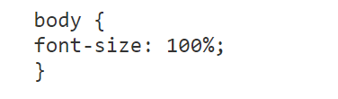
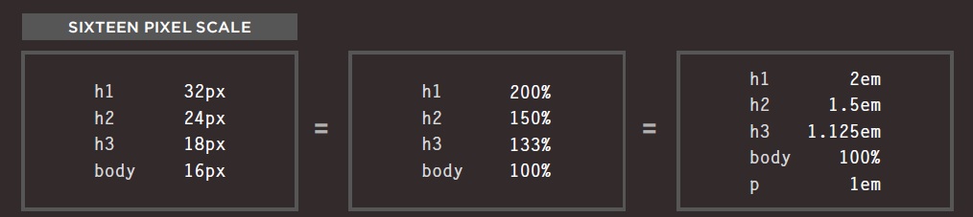
Skrift højde % c473
Notes:
Hvorfor bruger vi ikke px?

Slide 15
Discussion why do we need to have relative CSS size?

Slide 16
CSS Box model

Slide 17
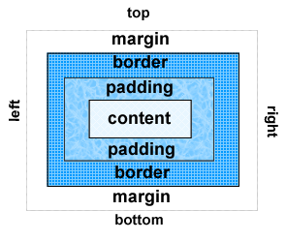
The Box Model
Content
Padding
Border
Margin

Slide 18
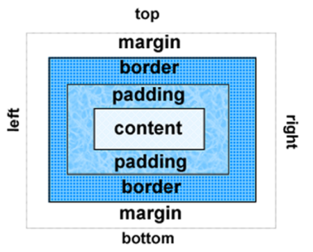
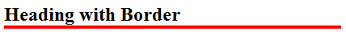
Configuring Specific Sides of a Border
Use CSS to configure a line on one or more sides of an element
border-bottom
border-left
border-right
border-top
h2 { border-bottom: 2px solid #ff0000 }

Slide 19
Css demo fra xbi
cssboxmodel.html

Slide 20
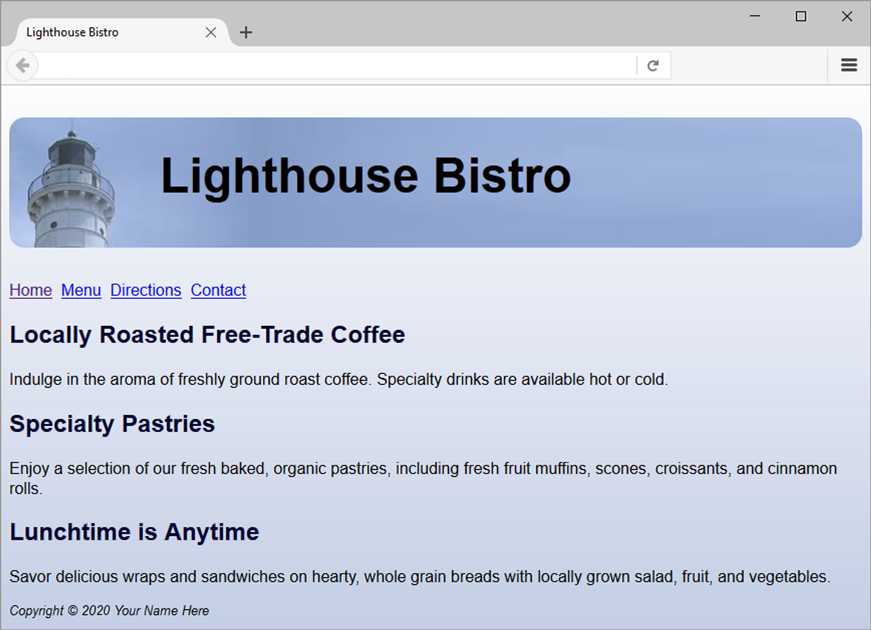
Case study
bistro

Slide 21
Status samtale

Slide 22
BEM-

